Slide 1
Home Loan Approval Prediction

Slide 2
Problem Statement
A Company which deals in all home loans wants to automate the loan eligibility process (real-time) based on customer detail provided while filling out the online application form.
These details are Gender, Marital Status, Education, Number of Dependents, Income, Loan Amount, Credit History and others.
Our project objective is to predict Loan Statues based on applicant data.

Slide 3
Dataset Description
Dataset consists of 1009 row, 13 attribute.
Attributes :
Loan_ID : unique loan ID.
Married (yes/no).
Education (graduate/not graduate).
Applicant Income.
Loan Amount.
Credit_History
Loan_Status (yes/no) → target attribute.
Gender (male/female).
Dependents : number of dependents.
Self-Employed (yes/no).
Coapplicant Income.
Loan_Amount_Term : term of loan in months.
Property_Area (Urban, Semiurban, Rural).

Slide 4
Data Preprocessing
Check missing values.
Check duplicates.
Category encoding.
Feature scaling (Normalization).
Detect and remove outliers.

Slide 5
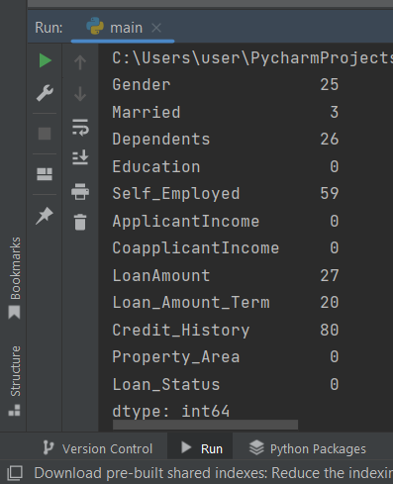
Handling Missing Values
First count missing values using isna() and sum() functions then replace it applying suitable technique using function fillna().
- fill with mean for numerical data.
- fill with mode for categorical data.

Slide 6
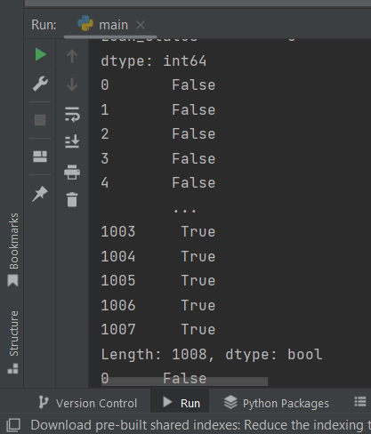
Check Duplicated
Using duplicated() function
There was 27 duplicated rows.
Drop them using drop_dublicates().

Slide 7
Category Encoding
→ Applying encoding to categorical attributes to make it easier to deal with it by converting to numerical values using replace() function
Feature Scaling ( Normalization)
→ We applied Min_Max scaler to scale numerical attributes to specific range [0.0, 1.0] to provide better results.

Slide 8
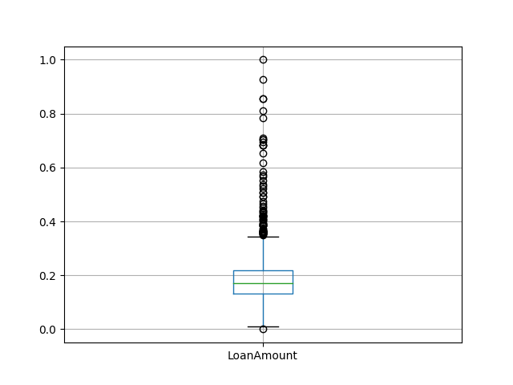
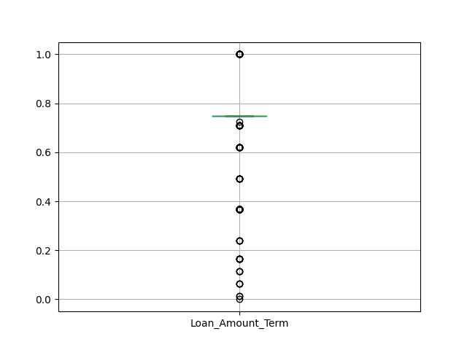
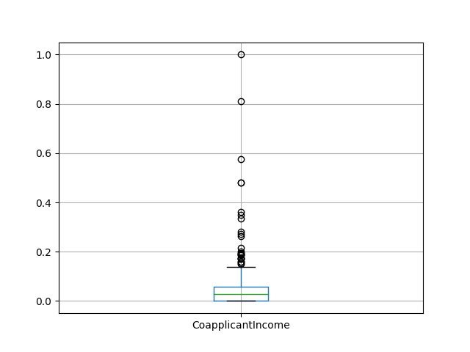
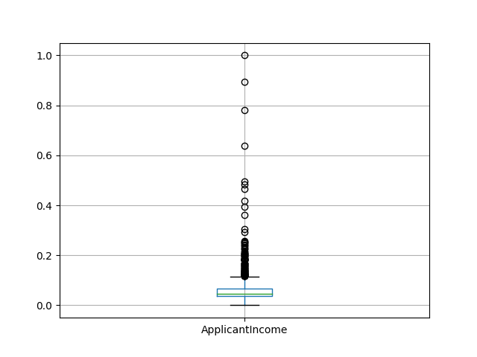
Detect Outlier
→ Visualize data using box plot to show if there is outlier.

Slide 9
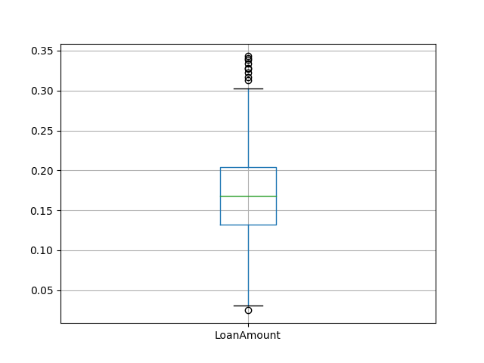
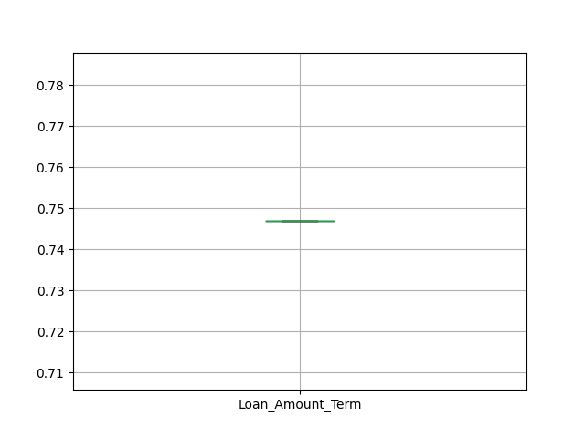
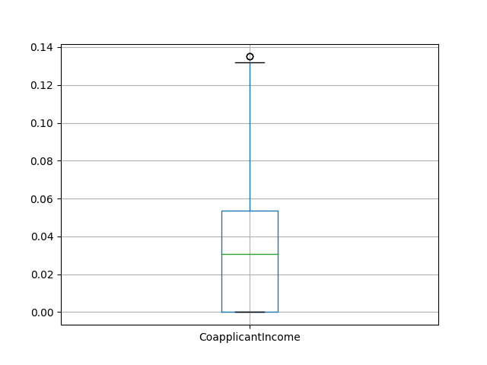
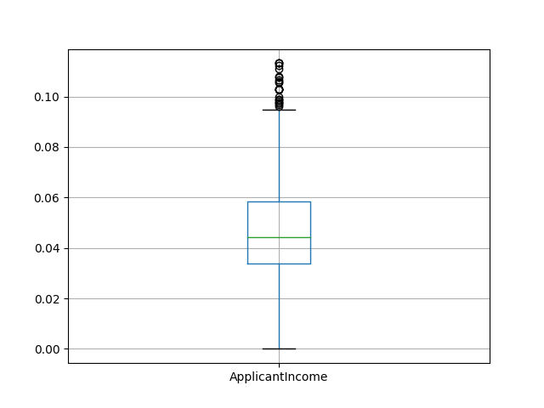
Remove outlier
→ Removing by applying this formula :
(Q3 + 1.5 * IQR) < outlier < (Q1 - 1.5 * IQR)
→ Data after removing outlier

Slide 10
Summary Statistics

Slide 11
Apply statistics functions to explore numerical attributes using :
- describe() function that calculate mean, standard deviation, min and max value
and other measures.
- median() - mode() - var()
Apply value_counts() function for categorical attributes that count number of each distinct value in it.

Slide 12
Visualization

Slide 13
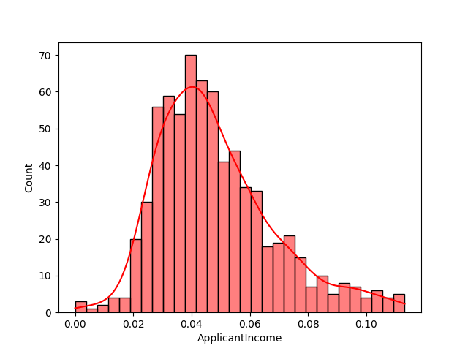
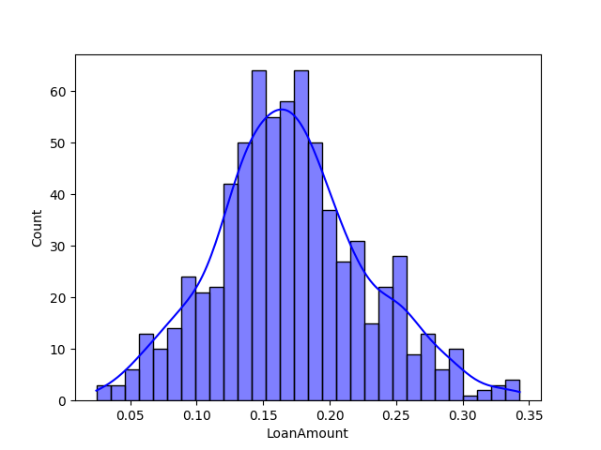
Study Data Distribution
Using Histogram.
“ Right Skewed” “Normal Distribution”

Slide 14
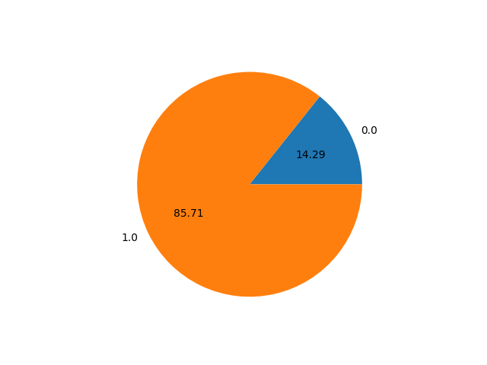
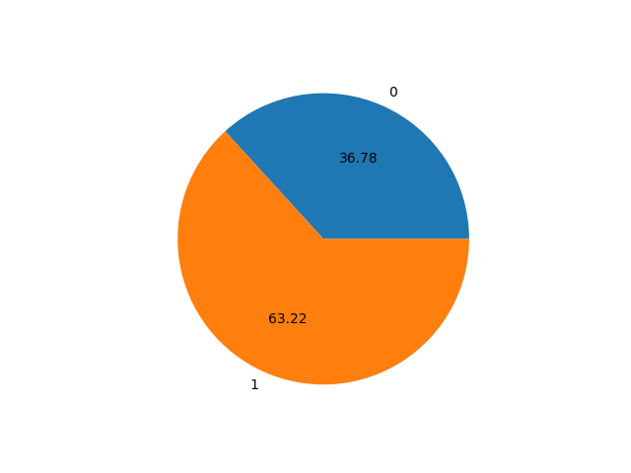
Visualize Some Categorical Data
Using pie chart.
“Credit_History” “Married”

Slide 15
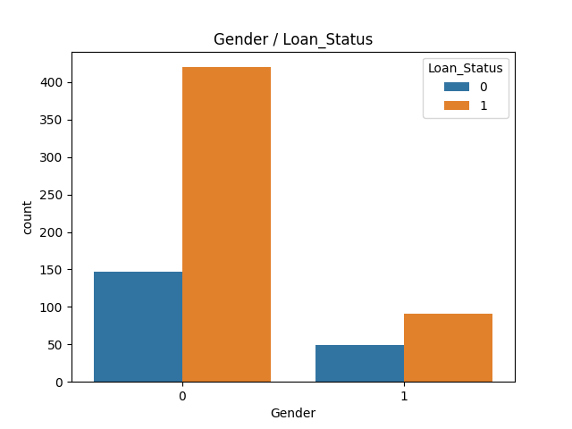
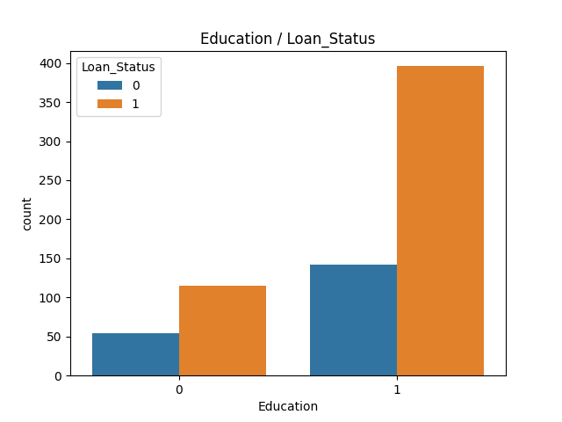
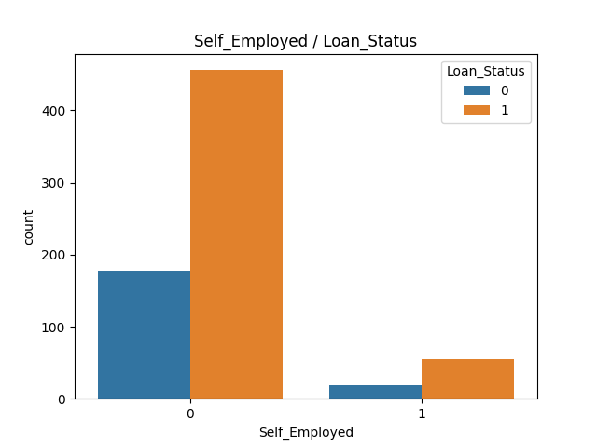
Study Impact of Some Attributes on Loan Status
Using count plot.
Plots show that loan statues are nearly similar in this cases, so these attributes have No huge impact on loan status.

Slide 16
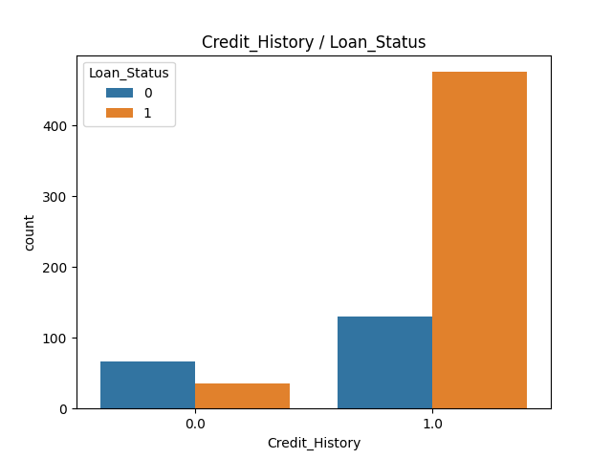
Study Impact of Some Attributes on Loan Status
→ Credit_History attribute.
→ Using count plot.
→ Observation :
Plot show that the Loan approvals are more in case of Applicants having Credit History.
So, this attribute has significant impact on Loan Status.

Slide 17
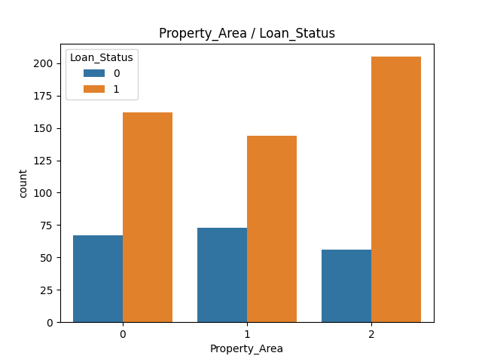
Study Property_area Attribute
→ Using count plot.
→ Observation :
Highest number of loans are in Semi-urban aera.
Loan approval or rejection is nearly same in all three property areas, so this attribute has No huge impact on loan status.

Slide 18
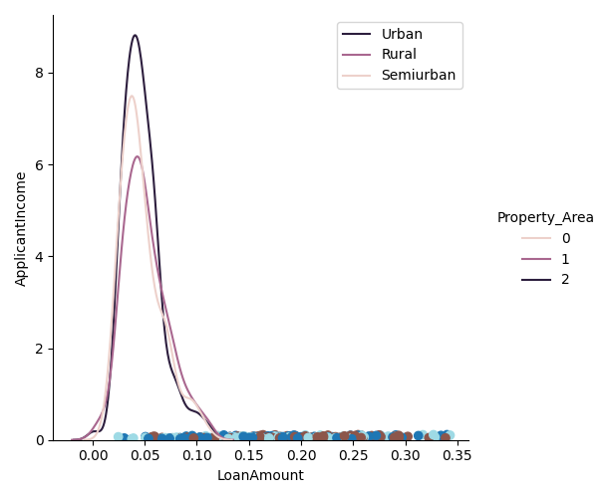
Study Area According To Applicant Income
→ Using density plot on property area and applicant income attributes.
→ Observation :
It seems like high income applicants are more to chose Urban area followed by Semiurban then Rural area.

Slide 19
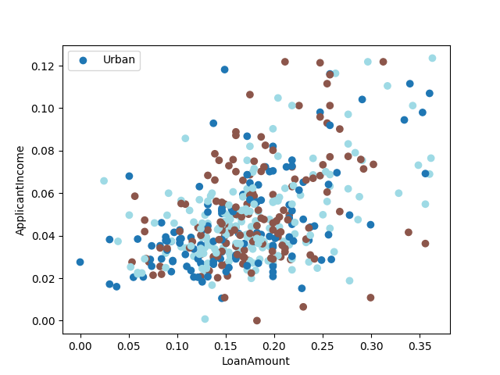
Study Impact of Income on Loan Amount
Using Scatter plot on applicant income and loan amount attributes grouped by property area.
Observation :
The approved loan amount is increasing with increase in the Income of applicant.

Slide 20
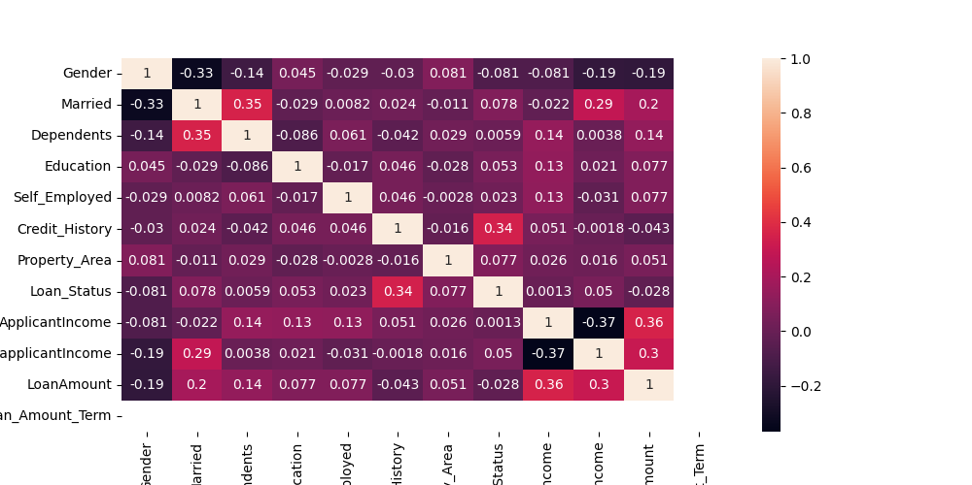
Study Relationships Between Attributes
→ By applying correlation, visualize using heat map.
→ Observation :
There is strong positive correlation between
- (Applicant_Income, loan_Amount(0.36)) - (Credit_History, Loan_Status(0.34))
There is negative strong correlation between
- (Applicant_Income, Coapplicant_Income (-0.37))

Slide 21
Classification

Slide 22
Steps
Splitting data to train and test using train_test_split() function with test size 30%.
We tried 4 different classification algorithms by first creating the model then fit() it to our training data, then we predict() our test data and check model efficiency by calculating accuracy_score().
Then we check model efficiency by calculating accuracy_score() and results was as follow :
So Random Forest classifier is the best classifier.
KNN classifier scored 73.23%
Random Forest classifier scored 76.05%
Decision Tree classifier scored 68.5%
Naïve Bayes classifier scored 69.9%

Slide 23
THANK YOU

